Slide 1
CHAPTER - 4
FOREST SOCIETY AND COLONIALISM

Slide 2
Why Deforestation?
DEFORESTATION: Deforestation is cutting down of trees indiscriminately in a forest area. Under the colonial rule it became very systematic and extensive.
Why Deforestation?
The disappearance of forests is referred to as deforestation.
Deforestation is not a recent problem. The process began many
centuries ago; but under colonial rule it became more systematic and

Slide 3
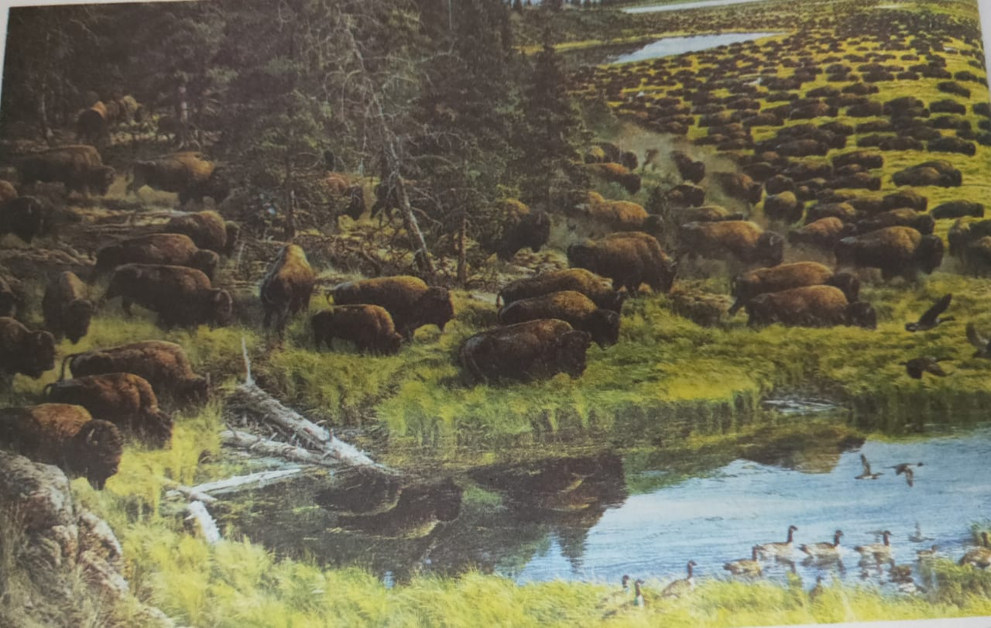
Land to be Improved
1.the British directly encouraged the production of commercial crops like jute, sugar, wheat and cotton.
2.foodgrains were needed to feed the growing POPULATION

Slide 4
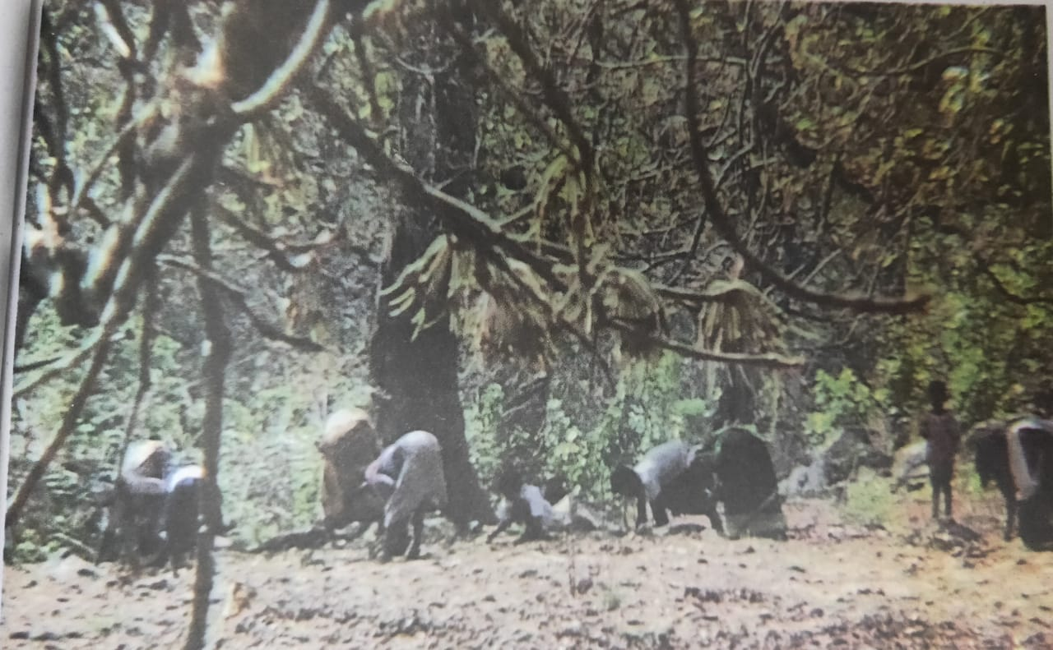
Sleepers on the Tracks
1.Sleepers – Wooden planks laid across railway
tracks; they hold the tracks in position
2.The spread of railways from the 1850s created a new demand.
3. By the early nineteenth century, oak forests in England were
disappearing. This created a problem of timber supply for the Royal
Navy

Slide 5

Plantations
Large areas of natural forests were also cleared to make way for
tea, coffee and rubber plantations to meet Europe’s growing need
for these commodities.

Slide 6
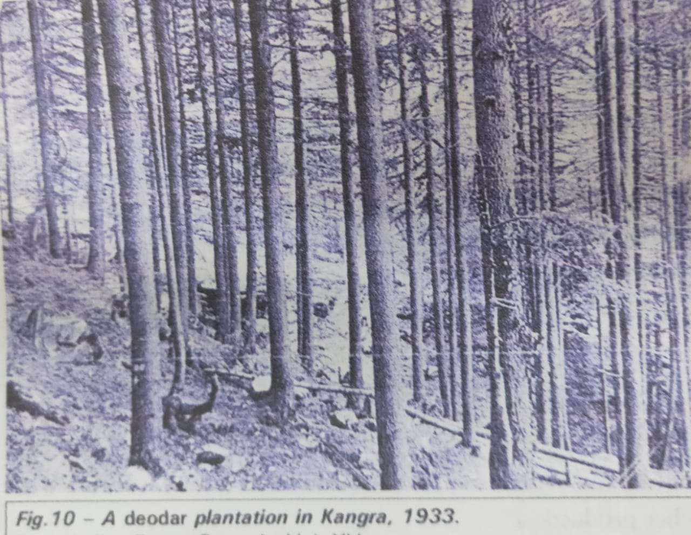
The Rise of Commercial Forestry
Brandis set up the Indian Forest Service in 1864 and helped formulate the Indian Forest Act of 1865. The Imperial Forest Research Institute was set up at Dehradun in 1906. The system they taught here was called ‘scientific forestry’.

Slide 7
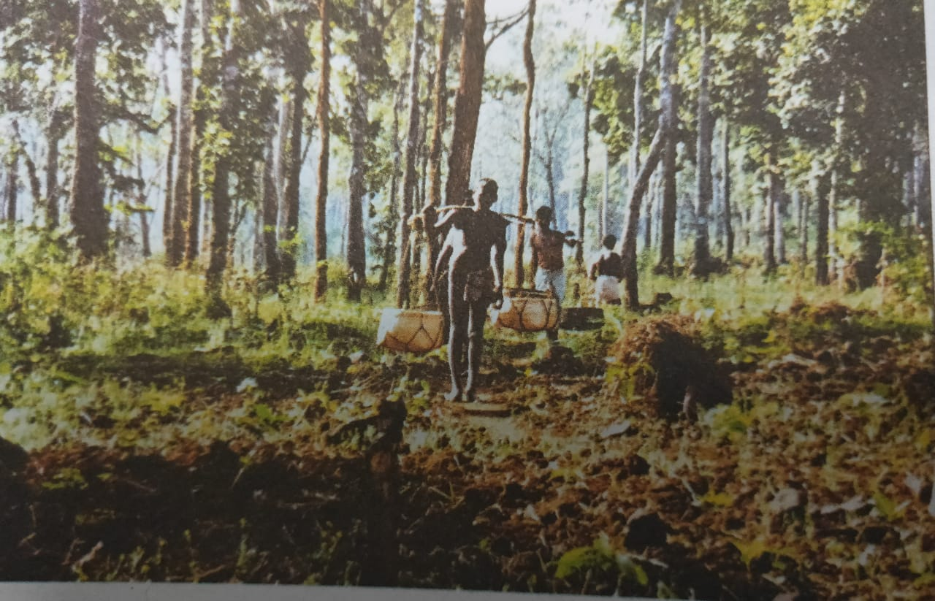
NATURAL FOREST LOST
Many people now, including ecologists, feel that this system is not scientific at all. In scientific forestry, natural forests which had lots of different types of trees were cut down. Intheir place, one type of tree was planted in straight rows. This is called a plantation.

Slide 8
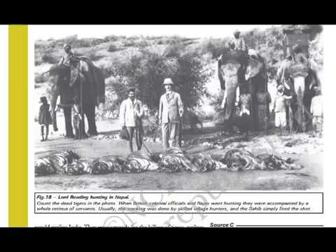
FOREST SURVEY
Forest officials surveyed the forests, estimated the area under different types of trees, and made working plans for forest management. They planned how much of the plantation area to cut every year. The area cut was then to be replanted so that it was ready to be cut again in some years

Slide 9
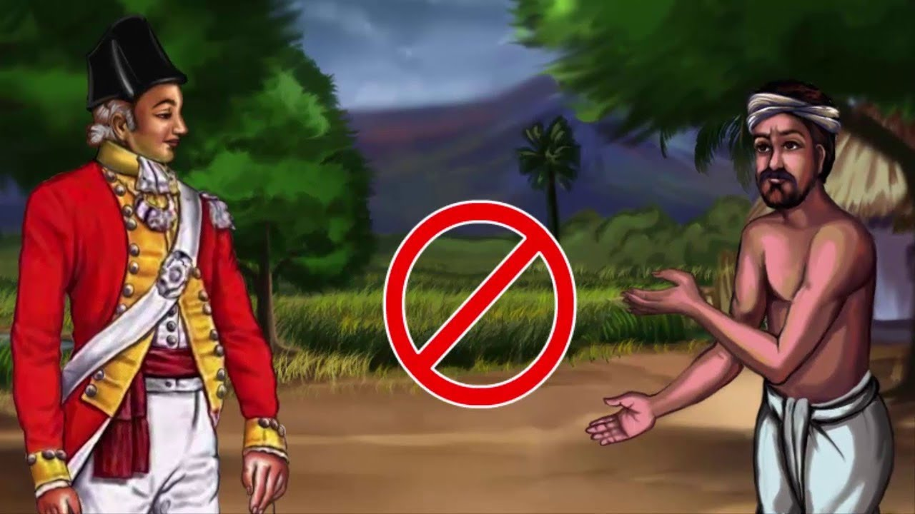
The Forest Act,1865
After the Forest Act was enacted in 1865, it was amended twice, once in 1878 and then in 1927. The 1878 Act divided forests into three categories: reserved, protected and village forests. The best forests were called ‘reserved forests’. Villagers could not take anything from these forests, even for their own use.

Slide 10
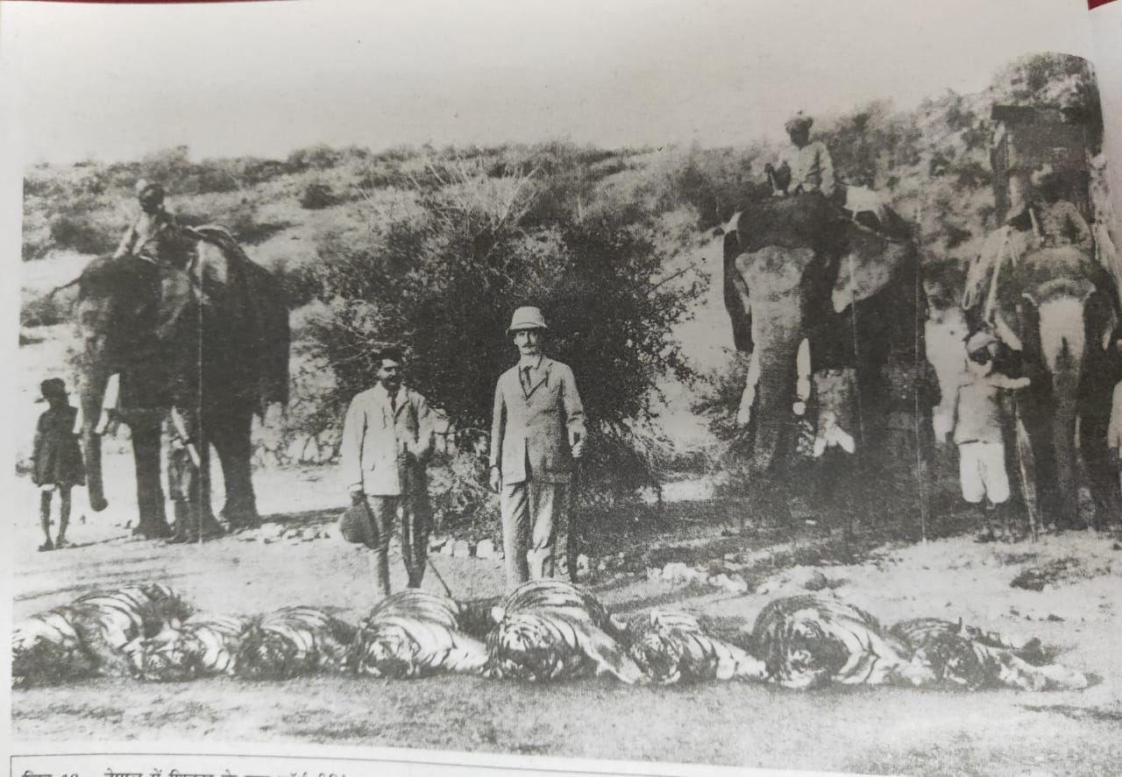
How were the Lives of People Affected?
A
1.Villagers wanted forests with a mixture of species
to satisfy different needs – fuel, fodder, leaves.
2.The forest department on the other hand wanted trees which were suitable for building ships or railways.
B.
In forest areas, people use forest products
1.Roots, leaves, fruits, and tubers.
2.Fruits and tubers are nutritious to eat.
3.Herbs are used for medicine

Slide 11
B.
In forest areas, people use forest products
4.wood for agricultural implements like yokes and ploughs, bamboo makes excellent fences and is also used to make
baskets and umbrellas.
5 .A dried scooped-out gourd-used as a portable water bottle.

Slide 12
In forest areas, people use forest products
6.The forest – leaves : disposable plates and cups,
7.The siadi (Bauhinia vahlii) creeper :ropes, and the
thorny bark of the semur (silk-cotton) tree is used to grate vegetables
8.Oil for cooking and to light lamps can be pressed from the fruit of
the mahua tree.

Slide 13
The Forest Act meant severe hardship for villagers across the country
Many communities left their traditional occupations and started trading in forest products.
many pastoralist and nomadic communities like the Korava, Karacha and Yerukula of the Madras Presidency lost their livelihoods.
They were forced to work instead in factories, mines and plantations, under government supervision.
In Assam, both men and women from forest communities like Santhals and Oraons from Jharkhand, and Gonds from Chhattisgarh were recruited to work on tea plantations.

Slide 14
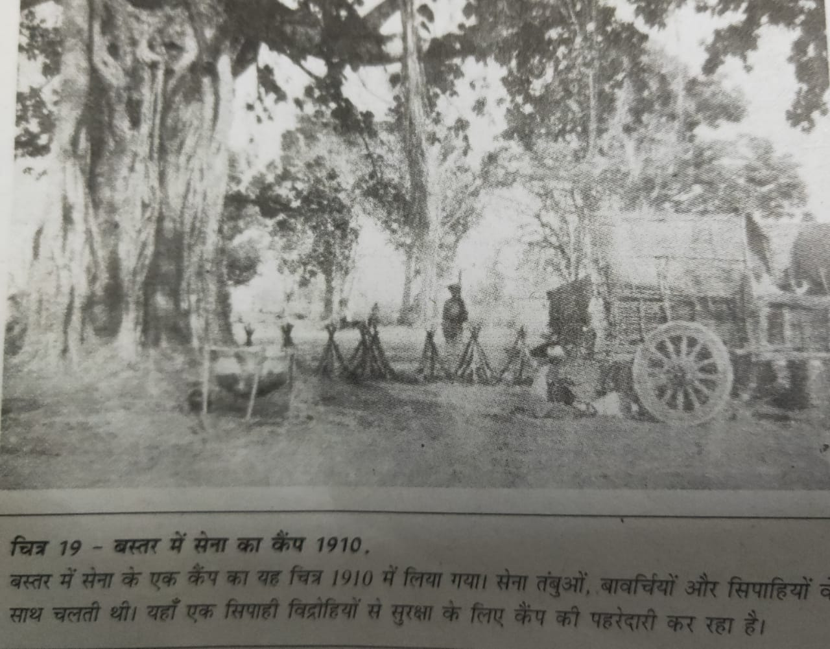
Rebellion in the Forest
Siddhu and Kanu in the Santhal Parganas,
Birsa Munda of Chhotanagpur
Alluri Sitarama Raju of Andhra Pradesh
Rebellion which took place in the kingdom of Bastar in 1910.

Slide 15
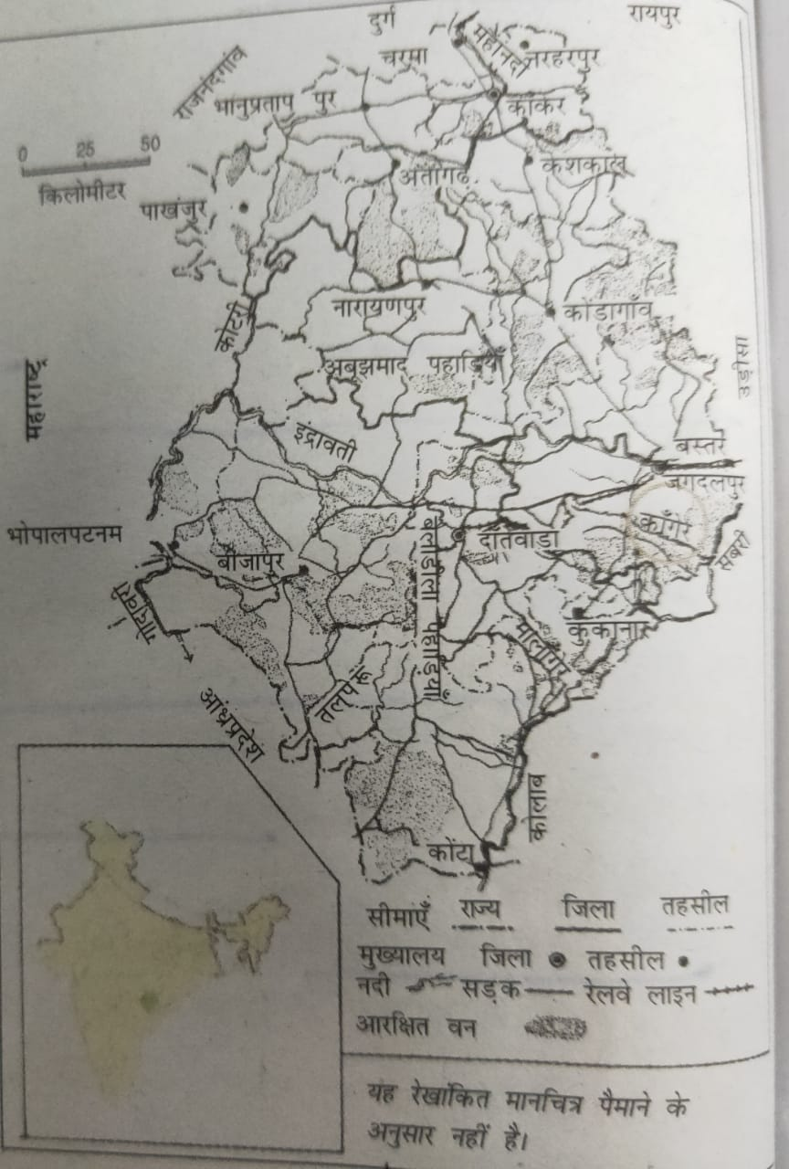
BASTAR
GEOGRAPHY LOCATION OF BASTAR
Located in the southernmost part of Chhattisgarh and borders Andhra Pradesh, Orissa and Maharashtra.
Central part of Bastar is on a plateau.
The north of this plateau is the Chhattisgarh plain and to its south is the Godavari plain.
The river Indrawati winds across Bastar east to west.

Slide 16
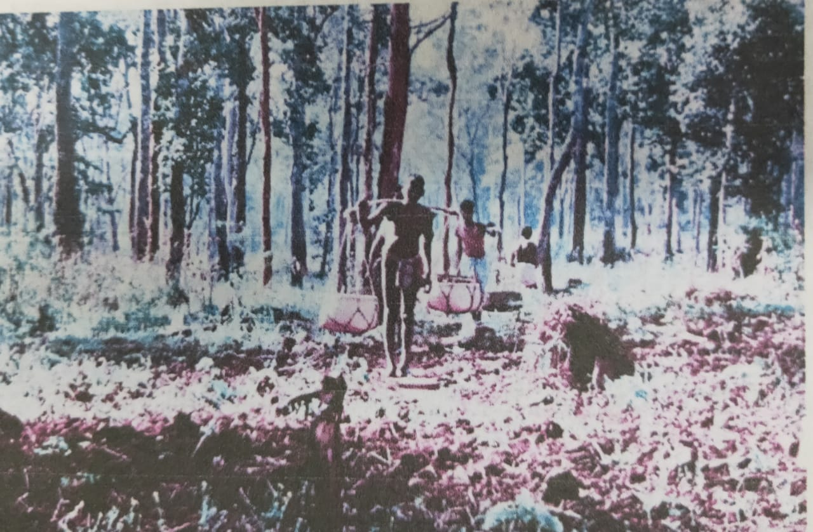
PEOPLE OF BASTAR
Communities live in Bastar such as Maria and Muria Gonds, Dhurwas, Bhatras and Halbas.
They speak different languages but share common customs and beliefs.
The people of Bastar believe that each village was given its land by the Earth.
They show respect to the spirits of the river, the forest and the mountain.
Every year there is one big hunt where the headmen of villages in a pargana (cluster of villages) meet and discuss issues of concern, including forests.

Slide 17
PEOPLE OF BASTAR
village knows where its boundaries lie, the local people look after all the natural resources within that boundary.( they pay a small fee called devsari, dand or man in exchange)
The people of Bastar were very worried, allowed to stay on in the reserved forests on the condition
They worked free for the forest department .
Displaced without any notice.
The terrible famines, in 1899-1900 and again in 1907-1908. Reservations proved to be the last straw.

Slide 18
PEOPLE OF BASTAR
The initiative was taken by the Dhurwas of the Kanger forest
There was no single leader, many people speak of Gunda Dhur, from village Nethanar, as an important figure in the movement. In 1910,
Rebel against the British, Most villages were deserted as people fled into the jungles.

Slide 19
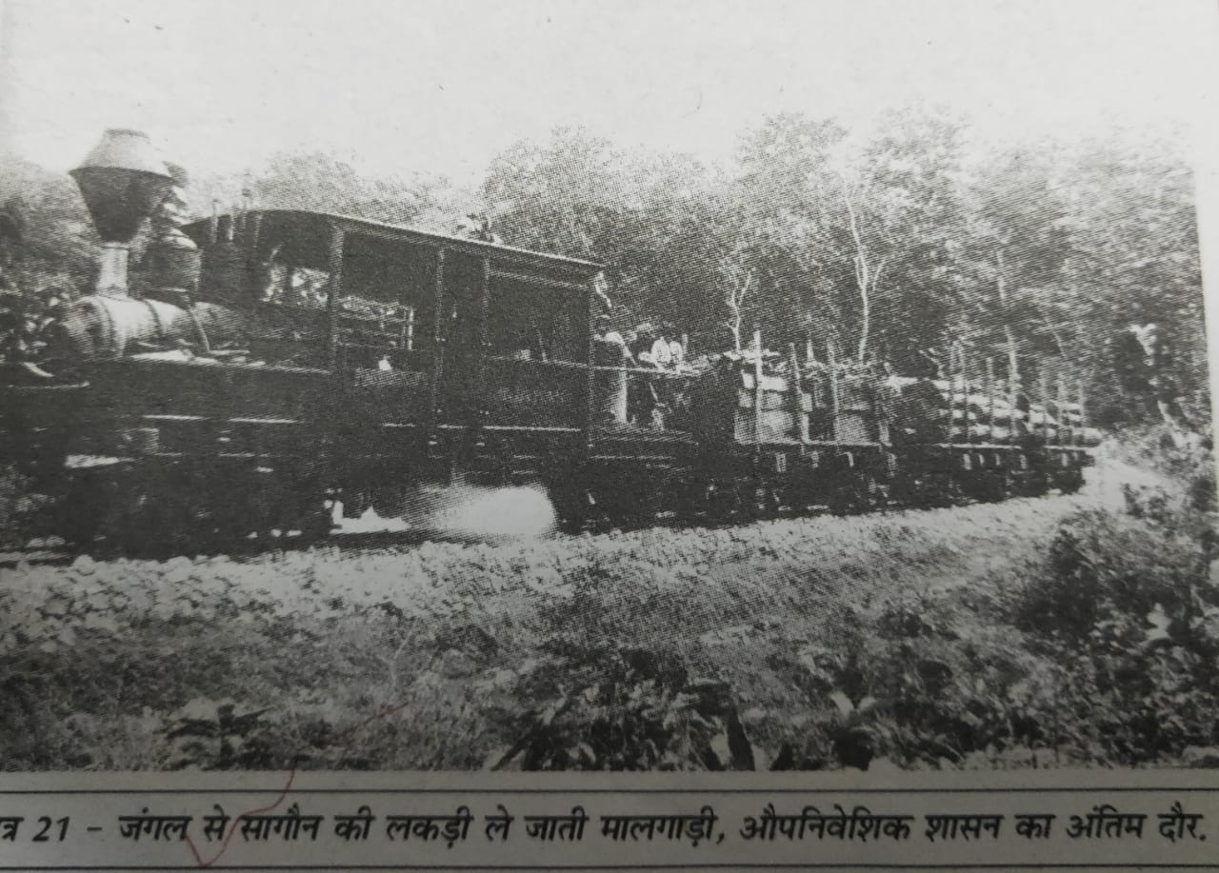
JAVA( INDONESIA)- Famous as a rice-producing island
The colonial power in Indonesia were the Dutch.
In 1600, the population of Java was an estimated 3.4 million.
The Kalangs of Java were a community of skilled forest cutters and shifting cultivators
In 1755 when the Mataram kingdom of Java split, the 6,000 Kalang families were equally divided between the two kingdoms.
Dutch tried to make the Kalangs work under them. In 1770, the Kalangs resisted by attacking a Dutch fort at Joana( Supperessed)
The Dutch enacted forest laws in Java, restricting villagers’ access to forests.

Slide 20
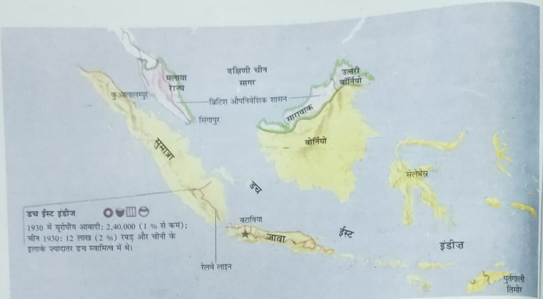
JAVA( INDONESIA)- Famous as a rice-producing island
In 1882, 280,000 sleepers were exported from Java alone
The Dutch first imposed rents on land being cultivated in the forest and then exempted some villages from these rents if they worked collectively to provide free labour and buffaloes for cutting and transporting timber. This was known as the Blandongdiensten system.
Around 1890, Surontiko Samin of Randublatung village, a teak forest
village, began questioning state ownership of the fores(the wind, water, earth and wood, so it could not own)
Soon a widespread movement developed.

Slide 21
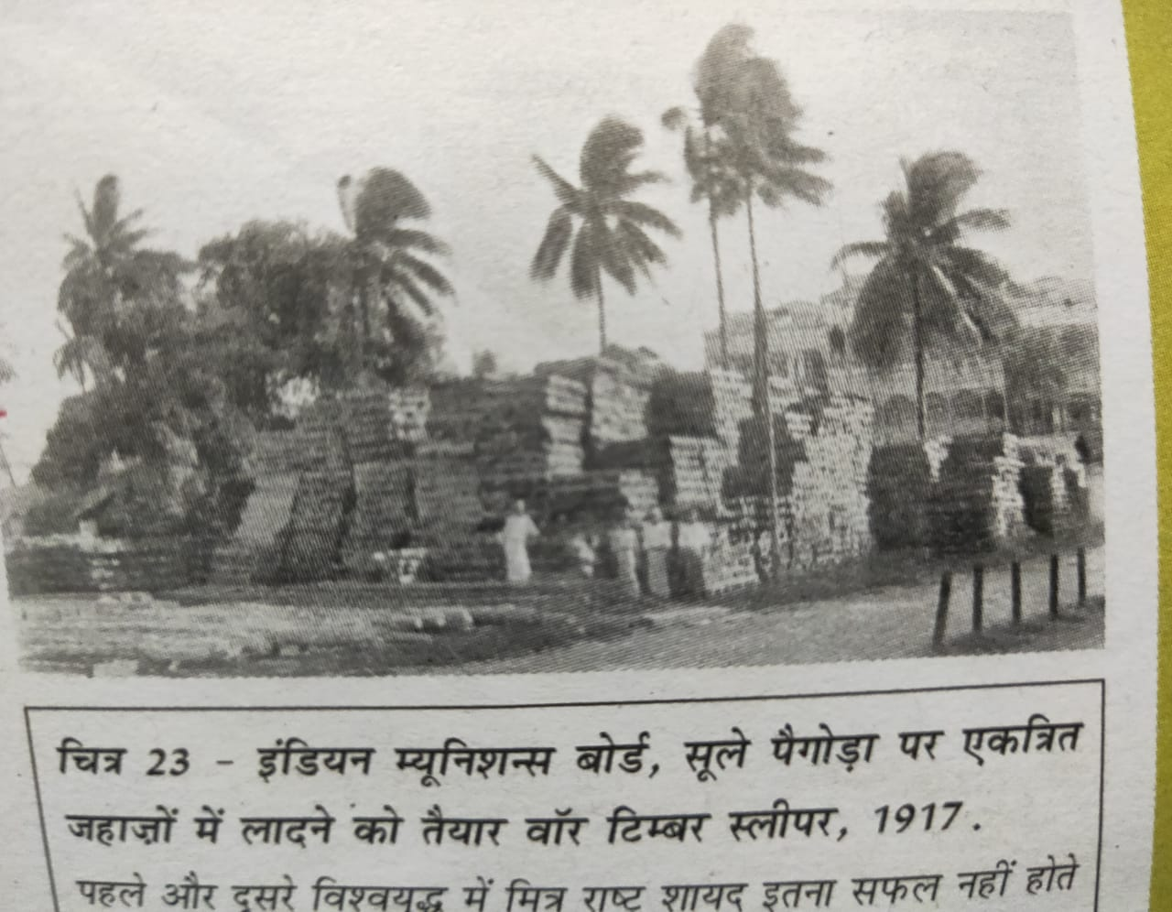
War and Deforestation(First World War and the Second World Wa
In India, working plans were abandoned at this time, and the forest department cut trees freely to meet British
In Java, just before the (Japanese occupied) the Dutch followed ‘a scorched earth’ policy, destroying sawmills, and burning huge piles of giant teak logs
The Japanese then exploited the forests recklessly .

Slide 22
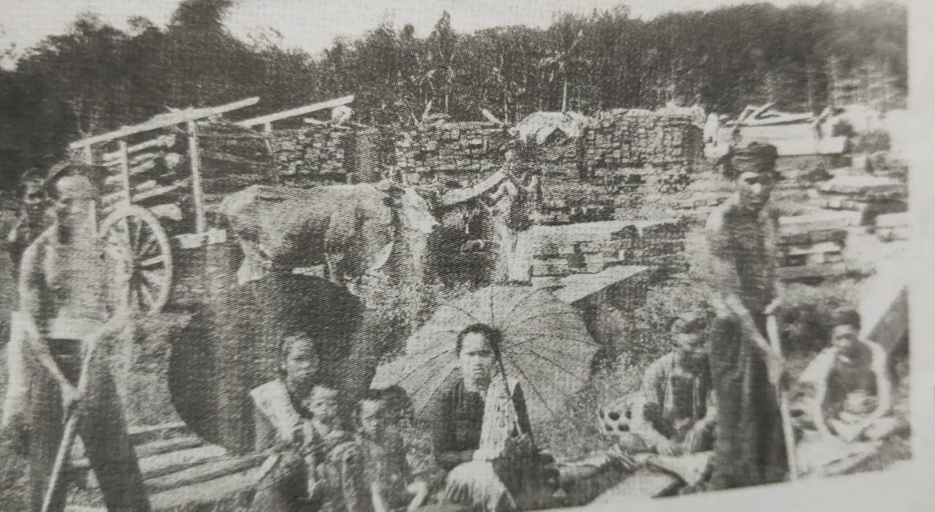
New Developments in Forestry
Since the 1980s, governments across Asia and Africa have begun to see that scientific forestry
Across India, from Mizoram to Kerala, dense forests have survived only because villages protected them in sacred groves known as sarnas, devarakudu, kan, rai.

